Slide 1
SHIRE MVP Plan
SHIRE MVP on RBC environment. (8 weeks)

Slide 2




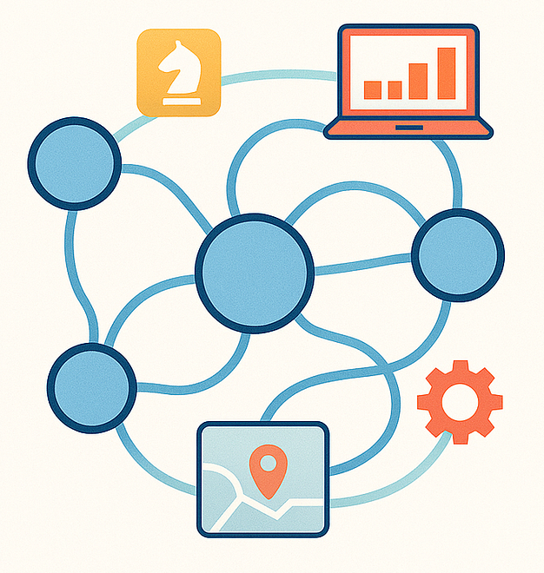
Current Procedure
Live VM with a vulnerability.
ssh
- SHIRE Agentic AI solution
Dev with knowledge of the:
VM (OS, app directory, file structure, libraries installed, and others)
Vulnerability (Vuln ID, CVE details, how to fix, previous resolution knowledge, resolution steps from internal tool)
- Vulnerability
- Live VM with vuln
- Tableau dashboard
- Developer

Slide 3









SHIRE Framework
memory
GraphDB
Redhat
Intent
classifier

Slide 4


SHIRE MVP
- SHIRE Agentic AI solution
- Vulnerability
- Live VM with vuln
- Tableau dashboard
- Developer
ssh
copilot
VM (OS, app directory, file structure, libraries installed, and others)
Vulnerability (Vuln ID, CVE details, how to fix, previous resolution knowledge, resolution steps from internal tool)
Local DB
To be added
User input

Slide 5
Core Elements
memory
Local DB
Used to save
Conversation History
Plans
State variables
Local database containing all CVEs
Used as alternative to API/internet
To be added
LLM for
Vulnerability understanding
Plan generation
All crucial functionalities
VM (OS, app directory, file structure, libraries installed, and others)
Vulnerability (Vuln ID, CVE details, how to fix, previous resolution knowledge, resolution steps from internal tool)
Intent
classifier
Crucial information containing details related to vulnerability and system.
(to be provided by user)
Identify Intent and redirect to the specific tool.
User input

Slide 6
Plan/Timeline
Week 2 – Design internal CVE Database and access it to generate plans
Week 3,4 – Work with team to integrate with copilot. / Dry run to identify which vulnerabilities to target.
Week 5,6,7,8 – Record logs for training/analytics purpose (application logs, workflow logs, plans, chat history, state variables, review/feedback from SME on plan)
Week 9,10 - Analyze recorded steps and work on designing autonomous workflow.
Week 11, 12 – Buffer time to deliver MVP

